Slide 1
IBD Patient Assessment and Empowerment Program (iPAEPS)
Version 2.0

Slide 2
V1.4 changes made
IBD activity module updated
Added missing 2nd goal on slide 50
Updated medications module; note that each drug dropdown box will have its own unique dosage patterns and entry method (oral, suppository, or injection)
Added another option to “what pre-set programs would you like to run” slide
V1.5 changes made
Added icon to start page
Added scoring instructions to medical adherence scale (Agree = 1; Disagree = 0; sum all items to give a score out of 5; save score and identify on report)
Corrected options on “Problems/barriers I’m currently facing in relation to managing my IBD?” slide
Updated text on “What goals would you like to achieve” slide.

Slide 3
V1.6 changes made
Patient ID module moved to be before the “IBD Patient Assessment and Empowerment Program (iPAEPS)” slide – this move is done because it will NOT be the patients that enters the patient ID but the doctor or nurse
Added question to the demographics section: “How many months ago did you last see your gastroenterologist? Dropbox range: 0-48, 49+”
Added 3 questions (new slide) to the end of the IBD activity section “Compared to your last visit to the gastroenterologist , how would you describe the status of your IBD symptoms now? Compared to your last visit to the gastroenterologist , how would you describe the status of your PAIN now? Compared to your last visit to the gastroenterologist , how would you describe any changes to the frequency of bowel motions now? (visual analog scale)”

Slide 4
V1.7 changes made
Reversed visual analogue scoring for the 3 questions on the last slide for “IBD activity (continued)”
Updated medications section (see excel sheet)
Updated review goals section (see excel sheet)
Updated goals section (see excel sheet)
V1.8 changes made
Added comment in RED to the What pre-set programs would you like to run? Slide
Made two reports DOCs, one BRIEF and one FULL
Modified printing options in slide entitled “Settings – What would you like to print?”

Slide 5
V1.9 changes made
All changes in RED throughout document
Added gastroenterologist textbox to Patient ID module
Any modules not assessed removed from printed report OR says “Not assessed” (would prefer removed from report.
IBD activity – questions modified “Over the past week, how many bowel movements have you had per day?” and “Over the past week, how many of your bowel movements have been loose/watery stools per day?”
IBD activity – “Please tick any complications you are currently experiencing. ADDED “(Please select as many as relevant)”
Medication adherence – changed question to “Sometimes I forget to take my IBD medications” and “Sometimes I’m too busy to take my IBD medications“
Settings what would you like to print, changes button to “CHOOSE USER RESPONSE”
Updated text in excel file
Mental health review slide – moved full stop - “Please move the red rectangle along the line to indicate how you would rate the quality of sleep you attain in an average 24 hour period (higher scores indicate greater quality of sleep).” and “Are you CURRENTLY seeing a mental health professional?” and “Do you have an appointment with a mental health expert within the next 14 days or are you willing to contact your local doctor (GP) if your mental health symptoms worsen?”
Post-feedback slide changes sentence “How likely are you to follow up on the advice that was provided?”
Your diet slide change in sentence “The following set of questions asks about your dietary patterns.”
Confidence levels regarding your health slide change in sentence “Please rate your overall level of self-confidence when it comes to quitting smoking“
What goals would you like to achieve slide sentence change “In this section, we would like you to identify up to 3 goals in relation to your IBD that you would like to achieve between now and your next appointment.”
Added slide in module 11 entitled “Any other comments/feedback?”

Slide 6
V2.0 changes made
All changes in PURPLE throughout document
Patient ID slide – added “Site: DROPBOX 1-20” (OPTIONAL RESPONSE) question
Corrected questions in IBD activity section. Added a further STOMA question

Slide 7
Background:
Individuals with IBD will complete a series of modules via the android application, preselected by me/staff while waiting to see their gastroenterologist. Participants must complete every question, and if any questions are left unanswered, the program will identify the questions which remain unanswered in order to prompt completion.
All participants’ data will be stored on the SD or USB card where the program was initiated. Data will be stored in sequential tabular form that can be imported into excel. Each participant’s dataset will be added to the larger dataset sequentially. Date and time of data collection for each participant will also be recorded. As per the previous app, colour of questions change once completed.
All data to be printed out in a report, except when modules are not assessed – then they are removed from printed report OR says “Not assessed” (would prefer removed from report.

Slide 8
Modules
Patient ID
Demographic details
Disease activity
Medications
Medication adherence
Pain symptoms
Body image; patient able to identify where pain is and give a VAS rating (severity), pain duration and form
Mental health status
VAS stress, anxiety, depression, fatigue sleep, sleep (hours),
Includes K10 (with feedback)
Mental health status (patient feedback)
Diet
Patient confidence
Patient questions/concerns
Responses to past goals
Setting goals to better manage my IBD
Identifying problems/barriers I’m currently facing in relation to managing my IBD
Program evaluation (patient feedback)

Slide 9




IBD Patient Assessment and Empowerment Program (iPAEP)
Click on this button results in the user having to enter a password to get to the settings section
Click on this button results in the user going to the next screen
Program designed and developed
by MindOverGut© 2014

Slide 10
1. Patient ID

Slide 11
Patient ID:
Patient ID: ______________
Gastroenterologist: ______________
Site: DROPBOX 1-20 (OPTIONAL RESPONSE)
Click on this button results in the user going to the next screen; only after all information has been entered

Slide 12
IBD Patient Assessment and Empowerment Program (iPAEPS)
This program will ask you a range of questions about your IBD, pain, mental health, goals, current concerns, and questions you wish to ask in the session with your gastroenterologist.
Total time to complete this assessment will be around 10-20 minutes.
If you have any concerns, please talk to your
nurse or Gastroenterologist.
Click on this button results in the user having to enter a password to get to the settings section
Click on this button results in the user going to the next screen
Program designed and developed
by MindOverGut© 2014

Slide 13
2. Demographic details

Slide 14
Demographic details
Age? Dropbox range: 16-100
Gender? Dropbox options: ☐ Male ☐ Female ☐ Gender non-specific
Marital status? Dropbox options: ☐ Single ☐ Married/de facto ☐ Separated/divorced ☐ Widowed
What is your highest level of education completed? Dropbox options:
☐ Primary school
☐ Secondary school
☐ Certificate
☐ Diploma
☐ Undergraduate degree
☐ Postgraduate degree
Is English your primary language? Dropbox options: ☐ Yes ☐ No
Click on this button results in the user going to the next screen; only after all information has been entered
How many months ago did you last see your gastroenterologist? Dropbox range: 0-48, 49+

Slide 15
3. IBD activity

Slide 16
IBD activity
The following set of questions asks about your IBD.
Condition: Dropbox options:
- Crohn's disease - Crohn's disease with Irritable Bowel Syndrome - Ulcerative colitis - Ulcerative colitis with Irritable Bowel Syndrome
- Indeterminate colitis
Number of years diagnosed with IBD? Dropbox range: 1-100
In the past 3 months my IBD has been: Dropbox options:
☐ Constantly active, giving me symptoms every day
☐ Often active, giving me symptoms most days
☐ Sometimes active, giving me symptoms on some days (for instance 1 – 2 days / week)
☐ Occasionally active, giving me symptoms 1 – 2 days / month
☐ Rarely active, giving me symptoms on a few days in the past 3 months
☐ I was well in the past 3 months, what I consider a remission or absence of symptoms.
Click on this button results in the user going to the next screen; only after all information has been entered

Slide 17

IBD activity (continued)
Use tick boxes rather than a dropbox
Over the past week, how many bowel movements have you had per day? | 0-30 dropbox
Over the past week, how many of your bowel movements have been loose/watery stools per day? | 0-30 dropbox
General well-being over the last week |  Very well  slightly below par  Poor  Very poor  Terrible
Click on this button results in the user going back to the previous screen OR to the start of the current module
Click on this button results in the user going to the next screen; only after all information has been entered

Slide 18
IBD activity (continued)
Over the past week, my rectal bleeding has been: |  None  Streaks of blood  Obvious blood  Mostly blood
Over the past week have you taken any antidiarrheal medication? |  Yes  No
Have you experienced a fever over the past week? |  Yes  No
Have you experienced an abdominal mass/tenderness over the last week? |  Yes  No
Have you experienced abdominal pain or cramping over the last week? |  None  Mild  Moderate  Severe
Use tick boxes rather than a dropbox
Click on this button results in the user going back to the previous screen OR to the start of the current module
Click on this button results in the user going to the next screen; only after all information has been entered

Slide 19
IBD activity (continued)
Please tick any complications you are currently experiencing. (Please select as many as relevant) | Nocturnal diarrhea Faecal incontinence Faecal urgency Nausea and /or vomiting  Joint pain and swelling (e.g., Arthralgia/arthritis) Irritations and inflammation of the eye (e.g., Iritis/uveitis) Inflammation of the skin (e.g., Erythema nodosum, Pyoderma gangrenosum) Mouth lesions (e.g., Aphthous stomatitis) Anal fissure, fistula or abscess  Other fistula
Use tick boxes rather than a dropbox
Click on this button results in the user going back to the previous screen OR to the start of the current module
Click on this button results in the user going to the next screen; only after all information has been entered

Slide 20
IBD activity (continued)
Do you have a stoma? |  No (if NO – no further questions skip next question).  Yes - Temporary Yes – Permanent
If yes, how many months have you had a stoma? | 0-60, 60+ dropbox
If yes, what type of stoma do you have? |  Colostomy Ileostomy Urostomy
Use tick boxes rather than a dropbox
Click on this button results in the user going back to the previous screen OR to the start of the current module
Click on this button results in the user going to the next screen; only after all information has been entered

Slide 21
IBD activity (continued)
Have you have been diagnosed with any of the following conditions along with IBD? (Please select as many as relevant) |  Irritable bowel syndrome  Chronic fatigue syndrome  Fibromyalgia  Primary sclerosing cholangitis (PSC)  Ankylosing spondylitis  Other: HAVE A TEXT BOX
Use tick boxes rather than a dropbox
TEXT BOX
Click on this button results in the user going back to the previous screen OR to the start of the current module
Click on this button results in the user going to the next screen; only after all information has been entered

Slide 22
IBD activity (continued)
Compared to your last visit to the gastroenterologist , how would you describe the status of your IBD SYMPTOMS now?
Score /100
No change
XXX
Much better
Much worse
Compared to your last visit to the gastroenterologist , how would you describe the status of your PAIN now?
Score /100
No change
XXX
Much better
Much worse
Compared to your last visit to the gastroenterologist , how would you describe any changes to the FREQUENCY OF BOWEL MOVEMENTS now?
Score /100
No change
XXX
Less frequent bowel movements each day
Many more bowel movements each day
Click on this button results in the user going back to the previous screen OR to the start of the current module
Click on this button results in the user going to the next screen; only after all information has been entered

Slide 23
4. Medications

Slide 24
Medications
Drug | Dosage, dosage and method of entry
Prednisolone (also known as Solone, Predsone, Panafcort) | 1mg, 2mg….60mg oral daily
Budesonide (also known as Entocort) | 3mg daily oral 6mg daily oral 9mg daily oral
Hydrocortisone | 100mg 6 hourly Intravenous
Sulfasalazine (also known as Salazopyrin, Pyraline) | 2g daily oral 4g daily oral
Mesalazine (also known as 5-aminosalicylic acid, 5-ASA, Pentasa, Mezavant, Salofalk) | 2g daily oral 1.5g daily oral 2.4g daily oral 3g daily oral 4g daily oral 4.8g daily oral 1g daily rectal (foam/enema/suppository) 2g daily rectal (foam/enema/suppository) 4g daily rectal (foam/enema/suppository)
Balsalazide (also known as Colazide) | 750mg (2 x twice per day) oral 750mg (3 x three times per day) oral
Azathioprine (also known as AZA, Imuran, Thioprine, Azapin, Azamun, Azahexal) | 50mg, 51mg….200mg daily oral
Allopurinol (also known as Zyloprim, Allohexal, Allosig, Progout) | 100mg daily oral
6-Mercaptopurine (also known as 6-MP, Purinethol) | 25mg daily oral 125mg daily oral
Methotrexate (also known as Ledertrexate, Methoblastin) | 15mg daily (with folate) oral 15mg weekly (with folate) injection 25mg weekly (with folate) injection
Infliximab (also known as Remicade) | 5mg/kg 8 weekly Intravenous
Adalimumab (also known as Humira) | 160mg (induction - subcutaneous injection) 40mg fortnightly (subcutaneous injection)
Tacrolimus (also known as Prograf) | 0.5mg daily oral 0.5mg daily (suppository)
Ciprofloxacin (also known as C-Flox, Ciloquin, Ciprol, Ciproxin, Ciloxan) | 500mg (twice per day) oral
Metronidazole (also known as Flagyl) | 400mg (twice per day) oral 400mg (three times per day) oral
The following set of questions ask about your medications you are currently taking.
Drug, drug dosage/drug entry method will each have a dropdown box, BUT each drug will have different dosages and drug entry methods. Users will first select drug and then base on this selection the next (dosage) dropbox will provide dosage/method of entry options – SEE ATTACHED excel sheet
IBD drug
Drug dosage and method of entry
IBD drug
Drug dosage and method of entry
IBD drug
Drug dosage and method of entry
IBD drug
Drug dosage and method of entry
What other medications are you taking?
TEXT BOX
Click on this button results in the user going to the next screen; only after all information has been entered (except text box which is optional)

Slide 25
5. Medication adherence

Slide 26
Medications adherence
The following set of questions ask about your IBD medication adherence habits
Use tick boxes rather than a dropbox
Sometimes I forget to take my IBD medications |  Agree  Disagree
Sometimes I’m too busy to take my IBD medications |  Agree  Disagree
Sometimes I don’t take my medications because I don’t like the side effects |  Agree  Disagree
Sometimes I avoid taking my medication as I feel its not natural to take them |  Agree  Disagree
I only take my medications when my symptoms get worse |  Agree  Disagree
Agree = 1
Disagree = 0
Sum all items to give a score out of 5; save score and identify on report
Click on this button results in the user going to the next screen; only after all information has been entered

Slide 27
6. Pain symptoms

Slide 28
Pain symptoms
Individuals with IBD can experience pain, especially during an active period of their disease. This section will ask you about your pain symptoms.

Slide 29
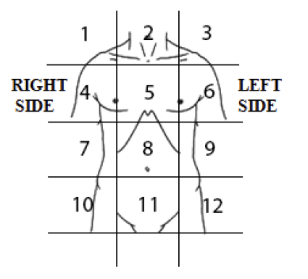
Your current experience of pain
Please identify up to THREE areas where you feel pain based on the number identified in the body figure
1st area
Location (selected a number located on the body picture): Dropbox range: 1-15
Form of pain: ☐ Sharp ☐ Dull ☐ Burning ☐ Aching ☐ Stabbing ☐ Tight
Duration of pain: Dropbox range:<10 minutes, 11-30minutes, 31-60 minutes, 1 hour….24 hours
Score /100
XXX
No pain
Severe pain
Click on this button results in the user going back to the previous screen OR to the start of the current module
Click on this button results in the user going to the next screen; only after all information has been entered

Slide 30
Your current experience of pain (continued)
Please identify up to THREE areas where you feel pain based on the number identified in the body figure
2nd area
Location (selected a number located on the body picture): Dropbox range: 1-15
Form of pain: ☐ Sharp ☐ Dull ☐ Burning ☐ Aching ☐ Stabbing ☐ Tight
Duration of pain: Dropbox range:<10 minutes, 11-30minutes, 31-60 minutes, 1 hour….24 hours
Score /100
No pain
Severe pain
XXX
Click on this button results in the user going back to the previous screen OR to the start of the current module
Click on this button results in the user going to the next screen; only after all information has been entered

Slide 31
Your current experience of pain (continued)
Please identify up to THREE areas where you feel pain based on the number identified in the body figure
3rd area
Location (selected a number located on the body picture): Dropbox range: 1-15
Form of pain: ☐ Sharp ☐ Dull ☐ Burning ☐ Aching ☐ Stabbing ☐ Tight
Duration of pain: Dropbox range:<10 minutes, 11-30minutes, 31-60 minutes, 1 hour….24 hours
Score /100
XXX
No pain
Severe pain
Click on this button results in the user going back to the previous screen OR to the start of the current module
Click on this button results in the user going to the next screen; only after all information has been entered

Slide 32
7. Mental health status

Slide 33
Mental Health Review
Mental health concerns are a common issue in patients living with IBD. This section will ask you about your mental health symptoms and provide feedback that may be of benefit.

Slide 34
Mental Health Review –
Anxiety, Depression, stress, and fatigue
Please move the red rectangle along the line to indicate how you feel at the moment. (higher scores indicate more intense symptoms)
Score /100
Not at all depressed
Extremely depressed
XXX
Not at all anxious
Extremely anxious
XXX
Not at all stressed
Extremely
stressed
XXX
No fatigue
Very
severe fatigue
XXX
Click on this button results in the user going to the next screen; only after all information has been entered

Slide 35
Mental Health Review –
Quality of life and social support
Please move the red rectangle along the line to indicate your global level of quality of life (higher scores indicate greater quality of life)
Score /100
Worst imaginable
quality of life
Perfect
quality of life
XXX
Please move the red rectangle along the line to indicate your global level of social support available to you (higher scores indicate greater levels of social support)
Very poor social support
Excellent social support
XXX
Click on this button results in the user going back to the previous screen OR to the start of the current module
Click on this button results in the user going to the next screen; only after all information has been entered

Slide 36
Mental Health Review - Sleep
Average number of hours sleep in the last 24 hours? | Dropbox response options: 1 hour, 2 hour, 3 hour,……..10+ hours)
Please move the red rectangle along the line to indicate how you would rate the quality of sleep you attain in an average 24 hour period (higher scores indicate greater quality of sleep).
Score /100
Very poor sleep quality
Excellent
sleep quality
XXX
Click on this button results in the user going back to the previous screen OR to the start of the current module
Click on this button results in the user going to the next screen; only after all information has been entered

Slide 37
Mental Health Review –
Suicidal ideation and help seeking
Do you consider hurting yourself, others, or feel suicidal? (IF YES give RED advice option) | YES | NO
Are you CURRENTLY seeing a mental health professional? | YES | NO
Do you have an appointment with a mental health expert within the next 14 days or are you willing to contact your local doctor (GP) if your mental health symptoms worsen? | YES | NO
Click on this button results in the user going back to the previous screen OR to the start of the current module
Click on this button results in the user going to the next screen; only after all information has been entered

Slide 38
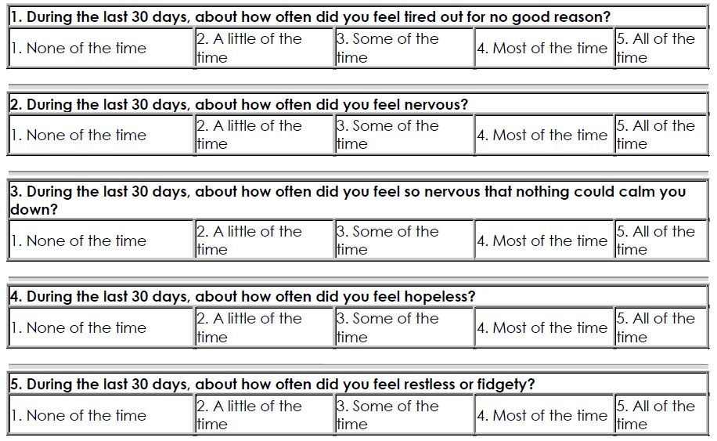
Mental Health Review
Select the answer for each question that best represents how you have been feeling over the past 30 days.
Click on this button results in the user going back to the previous screen OR to the start of the current module
Click on this button results in the user going to the next screen; only after all information has been entered

Slide 39
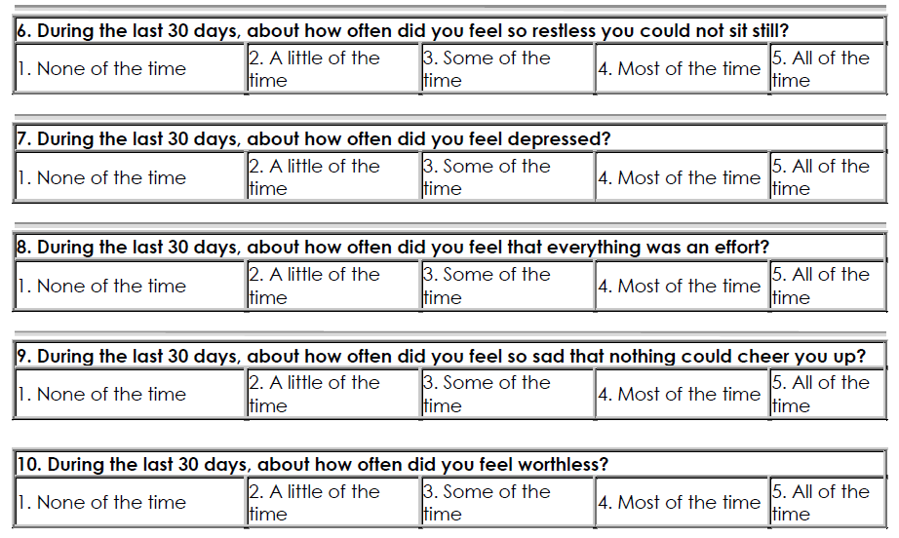
Mental Health Review (continued)
Select the answer for each question that best represents how you have been feeling over the past 30 days.
Click on this button results in the user going back to the previous screen OR to the start of the current module
Click on this button results in the user going to the next screen; only after all information has been entered

Slide 40

The K10 is scored in the following manner: a mark of 1 is given to any question answered with none of the time, a mark of 2 is given to any question answered with a little of the time, and so on up to 5 for questions answered with all of the time. Marked accordingly the K10 will result in a score range from 10 to 50; with higher scores indicating greater distress.
None of the time | A little of the time | Some of the time | Most of the time | All of the time
1 | 2 | 3 | 4 | 5
Saving K10 score (will not be displayed)

Slide 41
Please note:
Mental health concerns are a common issue in patients living with IBD. Based on your responses, the program has calculated your levels of psychological distress.
Please be aware that these results are only subjective. A comprehensive assessment by a trained mental health specialist is needed to confirm any diagnosis or symptom severity.
If you have any concerns or questions, please talk to your IBD nurse, gastroenterologist, medical practitioner or mental health professional (e.g., psychiatrist, psychologist).
Click on this button results in the user going to the next screen; only after all information has been entered

Slide 42

K10 score between 10-15
Individuals tend to report minimal levels of psychological distress
For further information and strategies to manage psychological distress related to IBD please go to IBDclinic.org.au
Click on this button results in the user going to the next screen; only after all information has been entered
If you have any questions or concerns please talk to your Gastroenterologist or IBD nurse

Slide 43
K10 score between 16-30
Individuals tend to report some symptoms which may be associated with psychological distress. These symptoms may be causing some distress in your life.
We recommend you meet with your mental health professional or doctor if symptoms worsen. For further information and strategies to manage psychological distress related to IBD please go to IBDclinic.org.au
Click on this button results in the user going to the next screen; only after all information has been entered
If you have any questions or concerns please talk to your Gastroenterologist or IBD nurse

Slide 44


K10 score between 31-50
Individuals tend to report strong and frequent symptoms which may be associated with psychological distress
Unless you are doing so already, we recommend you contact your mental health professional or doctor as soon as possible to arrange a mental health review.
Are you considering harming yourself or thinking about suicide?
Please talk about these thoughts/feelings with your Gastroenterologist/IBD nurse
Lifeline.org.au
Click on this button results in the user going to the next screen; only after all information has been entered
Please review these results with your Gastroenterologist or IBD nurse

Slide 45
8. Mental health status (patient feedback)

Slide 46
Post-feedback questions
How helpful was this advice?
1 | 2 | 3 | 4 | 5 | 6 | 7 | 8 | 9 | 10
Not at all helpful ☐ | ☐ | ☐ | ☐ | ☐ | ☐ | ☐ | ☐ | ☐ | Extremely helpful ☐
Use the 7-point scale you used in the previous tablet version
How likely are you to follow up on the advice that was provided?
1 | 2 | 3 | 4 | 5 | 6 | 7 | 8 | 9 | 10
Not at all likely ☐ | ☐ | ☐ | ☐ | ☐ | ☐ | ☐ | ☐ | ☐ | Extremely likely ☐
Click on this button results in the user going to the next screen; only after all information has been entered

Slide 47
Post-feedback questions (continued)
Did you experience any distress after receiving feedback about your results?
1 | 2 | 3 | 4 | 5 | 6 | 7 | 8 | 9 | 10
None at all ☐ | ☐ | ☐ | ☐ | ☐ | ☐ | ☐ | ☐ | ☐ | Extreme distress ☐
Use the 7-point scale you used in the previous tablet version
Are the results provided consistent with your sense of current mental health status?
1 | 2 | 3 | 4 | 5 | 6 | 7 | 8 | 9 | 10
Not at all ☐ | ☐ | ☐ | ☐ | ☐ | ☐ | ☐ | ☐ | ☐ | Very much so ☐
Click on this button results in the user going back to the previous screen OR to the start of the current module
Click on this button results in the user going to the next screen; only after all information has been entered

Slide 48
9. Diet

Slide 49
Your diet
The following set of questions asks about your dietary patterns.
Use tick boxes rather than a dropbox
Have you made any changes to your diet because of your IBD?
☐ No (SKIP TO THE THIRD LAST DIET QUESTION – next slide “Have you lost weight…”)
☐ Yes, minimal changes only
☐ Yes, significant changes
If YES, who has guided this change?
☐ I have made changes based on my symptoms
☐ Advice from friends/relatives
☐ The internet
☐ Dietitian
☐ Doctor
☐ Other (please specify): HAVE A TEXT BOX
If YES, which of the following diets are you following? You may select as many as apply.
☐Small, frequent meals
☐Low fat/fibre
☐Texture modified (e.g. puree/liquid diet)
☐High fibre
☐Low FODMAP
☐Low food chemical
☐ Elimination
☐Other (please specify): HAVE A TEXT BOX
Click on this button results in the user going back to the previous screen OR to the start of the current module
Click on this button results in the user going to the next screen; only after all information has been entered

Slide 50
Your diet (continued)
If YES, do you feel that these changes have improved your gastrointestinal symptoms?
☐ No
☐ Yes, a little
☐ Yes, a lot
Have you lost weight as a result of your IBD?
☐ No
☐Yes. Please specify how much over the 6 months (note: 1 kilogram = 2.2 pounds): dropbox options: <1, 1-100kg
Do you have any concerns in relation to your diet and IBD?
☐ No
☐ Yes
Use tick boxes rather than a dropbox
Overall, how healthy do you believe your diet is?
Very unhealthy
Very healthy
Click on this button results in the user going back to the previous screen OR to the start of the current module
Click on this button results in the user going to the next screen; only after all information has been entered

Slide 51
10. Patient confidence

Slide 52
Confidence levels relating to your health
The following set of questions ask about your confidence regarding a number of aspects of your health.
Use tick boxes rather than a dropbox
 | Very poor | Poor | Neither poor nor good | Good | Very good
Please rate your overall level of self-confidence when it comes to managing your own physical health? | ☐ | ☐ | ☐ | ☐ | ☐
Please rate your overall level of self-confidence when it comes to managing your own mental health? | ☐ | ☐ | ☐ | ☐ | ☐
Please rate your overall level of self-confidence when it comes to keeping physically fit? | ☐ | ☐ | ☐ | ☐ | ☐
Please rate your overall level of self-confidence when it comes to maintaining a healthy diet? | ☐ | ☐ | ☐ | ☐ | ☐
Please rate your overall level of self-confidence when it comes to taking your medication as recommended? | ☐ | ☐ | ☐ | ☐ | ☐
Please rate your overall level of self-confidence when it comes to quitting smoking ALSO NEED AN “N/A” OPTION | ☐ | ☐ | ☐ | ☐ | ☐
Click on this button results in the user going back to the previous screen OR to the start of the current module
Click on this button results in the user going to the next screen; only after all information has been entered

Slide 53
11. Patient questions/concerns

Slide 54
What would you like to discuss in today’s session with your gastroenterologist?
In our session today, I would like to talk about: (please tick as many that are relevant)
The status of my IBD
How do I get into remission? How long can I stay in remission?
 Review of recent diagnostic tests (e.g., imaging, blood test, stool test)
 General well-being (e.g. fatigue, energy levels, sleeping patterns)
Pain and pain management
Medication-based treatment strategies
Medication side-effects
Diet/nutrition issues
Dealing with stress
 Psychological-based treatment strategies
Managing fatigue/concentration concerns
 Exercise and IBD
 Complementary therapies
Impact of smoking
Support services
Sexual difficulties
Conception and pregnancy
Stoma management
Other IBD-related issues
Other: HAVE A TEXT BOX
Click on this button results in the user going to the next screen; only after all information has been entered

Slide 55
Any other comments/feedback?
TEXT BOX
Click on this button results in the user going to the next screen; only after all information has been entered
Click on this button results in the user going back to the previous screen OR to the start of the current module

Slide 56
12. Responses to past goals

Slide 57

How did you go at meeting your goals?
Since the last visit to the clinic, how did you go working towards your goals?
DROPBOX: Users will first select general area and then a specific goal - SEE ATTACHED excel sheet
1st goal:
DROPBOX General area > Specific goal
How did you go completing this goal?
No change
Complete success
2nd goal:
DROPBOX General area > Specific goal
How did you go completing this goal?
No change
Complete success
3rd goal:
DROPBOX General area > Specific goal
How did you go completing this goal?
No change
Complete success
Click on this button results in the user going back to the previous screen OR to the start of the current module
Click on this button results in the user going to the next screen; only after all information has been entered

Slide 58
13. Setting goals to better manage my IBD

Slide 59
What goals would you like to achieve
In this section, we would like you to identify up to 3 goals in relation to your IBD that you would like to achieve between now and your next appointment.
When thinking about setting goals, it is important to ensure that they are specific (e.g., I will engage in more relaxation each day), measurable (e.g., I will spent 10 minutes per day listening to a relaxation track while engaging in slow relaxed breathing), achievable (I will engage in this relaxation as soon as I get into bed to sleep), realistic (I have time to do this and it is not too difficult to do) and timely (I can achieve this every day for the next two weeks and then re-evaluate).
It is important that you discuss these goals with your gastroenterologist so they can help you to meet them.
Click on this button results in the user going to the next screen; only after all information has been entered

Slide 60
Goal setting:
I would like to set the following goals to attain between now and my next session:
DROPBOX: Users will first select general area and then a specific goal - SEE ATTACHED excel sheet
1st goal:
DROPBOX General area > Specific goal
How confident are you at completing this goal?
No confidence
Complete confidence
2nd goal:
DROPBOX General area > Specific goal
How confident are you at completing this goal?
No confidence
Complete confidence
3rd goal:
DROPBOX General area > Specific goal
How confident are you at completing this goal?
No confidence
Complete confidence
Click on this button results in the user going to the next screen; only after all information has been entered
Click on this button results in the user going back to the previous screen OR to the start of the current module

Slide 61
14. Identifying problems/barriers I’m currently facing in relation to managing my IBD

Slide 62
What problems/barriers do you find reduces your ability to manage your IBD?
In this section, we would like you to identify up to 3 problems/barriers in relation to managing your IBD.
It is important that you discuss these problems/barriers with your gastroenterologist so they can help you to overcome them.
Click on this button results in the user going to the next screen; only after all information has been entered

Slide 63
Problems/barriers I’m currently facing in relation to managing my IBD?
DROPBOX OPTIONS:
None (SKIPS REMAINING problem/barrier questions)
Pain
Fatigue/tiredness
Psychological distress
Poor diet
Smoking
Forget to take medications
Alcohol/drugs
Concentration problems
Forgetfulness
Lack of peer support
Financial problems
Difficulty moving
Work
Family
Other: HAVE A TEXT BOX
1st problem/barrier:
DROPBOX OPTIONS
How much impact does this problem/barrier have in your life?
No impact
Extreme impact
2nd problem/barrier:
DROPBOX OPTIONS
How much impact does this problem/barrier have in your life?
No impact
Extreme impact
3rd problem/barrier:
DROPBOX OPTIONS
How much impact does this problem/barrier have in your life?
No impact
Extreme impact
Click on this button results in the user going back to the previous screen OR to the start of the current module
Click on this button results in the user going to the next screen; only after all information has been entered

Slide 64
15. Program evaluation (patient feedback)

Slide 65
Feedback
How easy was it to use this tablet-based program?
1 | 2 | 3 | 4 | 5 | 6 | 7 | 8 | 9 | 10
Not at all ☐ | ☐ | ☐ | ☐ | ☐ | ☐ | ☐ | ☐ | ☐ | Extremely easy ☐
Use the 7-point scale you used in the previous tablet version
How helpful was it to use this tablet-based program?
1 | 2 | 3 | 4 | 5 | 6 | 7 | 8 | 9 | 10
Not at all ☐ | ☐ | ☐ | ☐ | ☐ | ☐ | ☐ | ☐ | ☐ | Extremely helpful ☐
Click on this button results in the user going to the next screen; only after all information has been entered

Slide 66
Feedback (continued)
Do you feel the information collected in this tablet-based program will help you and your gastroenterologist better manage your IBD in a collaborative way?
Use the 7-point scale you used in the previous tablet version
1 | 2 | 3 | 4 | 5 | 6 | 7 | 8 | 9 | 10
Not at all ☐ | ☐ | ☐ | ☐ | ☐ | ☐ | ☐ | ☐ | ☐ | Very much so ☐
Do you feel more motivated to manage your IBD after completing this tablet-based program?
1 | 2 | 3 | 4 | 5 | 6 | 7 | 8 | 9 | 10
Not at all ☐ | ☐ | ☐ | ☐ | ☐ | ☐ | ☐ | ☐ | ☐ | Extremely willing ☐
Click on this button results in the user going back to the previous screen OR to the start of the current module
Click on this button results in the user going to the next screen; only after all information has been entered

Slide 67
Thank you for your responses and feedback
Please return this tablet to reception
Touch here to go
back to start screen

Slide 68
Settings – Selection of modules

Slide 69
Settings
Include current options developed for the previous app

Slide 70
What pre-set programs would you like to run?
☐ Run all modules
☐ Patient ID, Disease activity, Medications, and Pain symptoms
☐ Patient ID, Disease activity, Medications, Pain symptoms, and Mental health status (with feedback) CHOOSE THIS OPTION IF YOU WISH TO USE A BRIEF REPORT
☐ Patient ID, Disease activity, Medications, Medication adherence, Pain symptoms, Mental health status (with feedback), and Patient questions/concerns
☐ Demographic details, Disease activity, Medications, Medication adherence, Pain symptoms, Mental health status (with feedback), and Patient questions/concerns
☐ Patient ID, Disease activity, Medications, Medication adherence, Pain symptoms, Mental health status (with feedback), Diet, Patience confidence, Patient questions/concerns, Responses to past goals, Setting goals to better manage my IBD, and Setting problems/barriers I’m currently facing in relation to managing my IBD
☐ All modules except program evaluation (patient feedback) and Mental health status (patient feedback)
☐ Demographic details, Mental health status (with feedback), and Mental health status (patient feedback)
☐ Custom (go to next slide)
Use tick boxes rather than a dropbox
Click on this button results in the user going back to home setting screen.

Slide 71
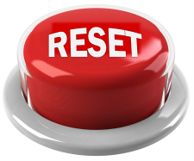
Custom: please identify number order of modules you wish to run:
Drop box (0-15) Patient ID
Drop box (0-15) Demographic details
Drop box (0-15) Disease activity
Drop box (0-15) Medications
Drop box (0-15) Medication adherence
Drop box (0-15) Pain symptoms
Drop box (0-15) Mental health status
With feedback
Without feedback
Drop box (0-15) Mental health status (patient feedback)
Drop box (0-15) Diet
Drop box (0-15) Patience confidence
Drop box (0-15) Patient questions/concerns
Drop box (0-15) Responses to past goals
Drop box (0-15) Setting goals to better manage my IBD
Drop box (0-15) Setting Problems/barriers I’m currently facing in relation to managing my IBD?
Drop box (0-15) Program evaluation (patient feedback)
Click on this button results all previous rankings being reset to “0”
NOTE: “0” = do not run/include
Click on this button results in the user going back to home setting screen.

Slide 72
Settings – Where do you want to print to?
Which printer would you like to print to?
Google cloud printer
Local printer
Click on this button results in the user going back to home setting screen.

Slide 73
Settings – What would you like to print?
Choosing brief report with use the brief report doc, while full report will use FULL report doc; will use docs even if information missing. Missing information will be identified in the printed docs as “details not reported”
SEE ATTACHED docs
What would you like to print?
BRIEF report (Incl. Patient ID, demographics, IBD status, medications, mental health status only)
BRIEF report with patient empowerment form
BRIEF report with IBDclinic.org.au flyer
BRIEF report with IBDclinic.org.au flyer and patient empowerment form
FULL report (all information collected)
FULL report with patient empowerment form
FULL report with IBDclinic.org.au flyer
FULL report with IBDclinic.org.au flyer and patient empowerment form
Click on this button results in the user going back to home setting screen.
CHOOSE USER RESPONSE
User then given option to choose which user

Slide 74
Settings – Separate printing options
Print off patient empowerment PDF?
Yes
No
Print off IBDclinic.org.au flyer?
Yes
No
SEE ATTACHED PDF
SEE ATTACHED PDF
Click on this button results in the user going back to home setting screen.
PRINT

